Slide 1
Year 6
Some of the best work 23.3.20 – 26.3.20

Slide 2
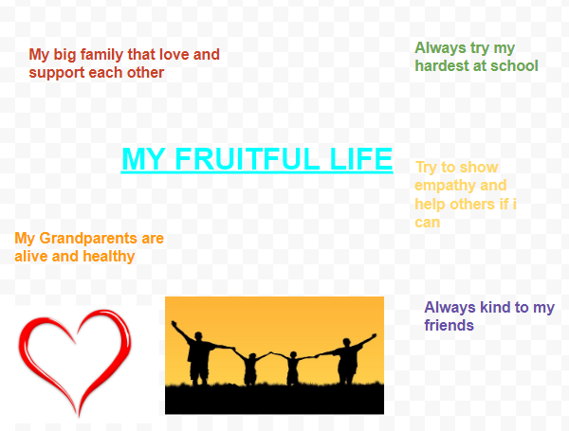
Jake

Slide 3
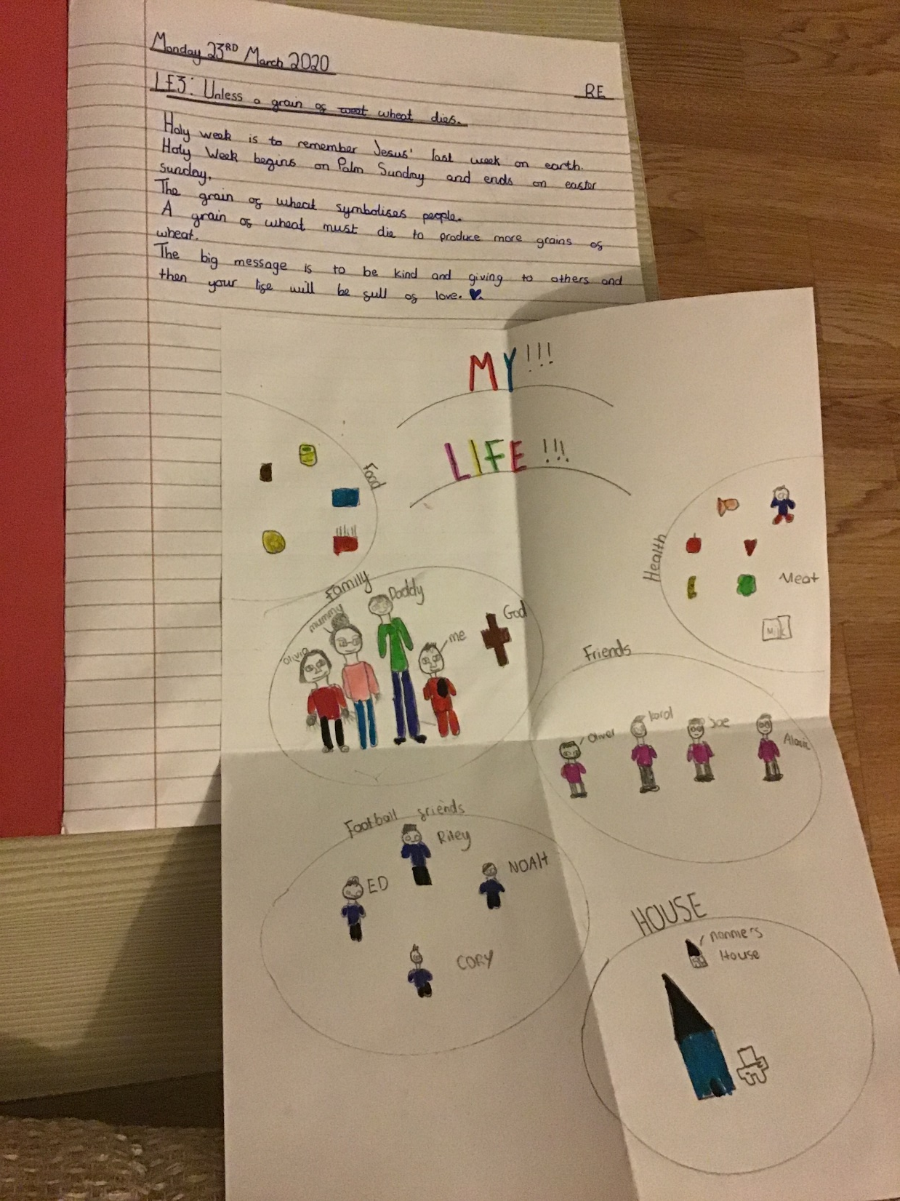
Thomas D

Slide 4
Katherine
RISING FROM THE DEAD
Martha and Mary try and console me but I’m glum
I won’t rest so don’t let me be
Will he come?
If only I could see him once more, it would please me
But I fall asleep in the hope of new life
Where is he?
I am alive again! I feel my limbs
I see many people, but it is dim
Is it him?
Everyone is joyful, though I feel fear
“My Lord, my Master!” I cry
He is here!

Slide 5
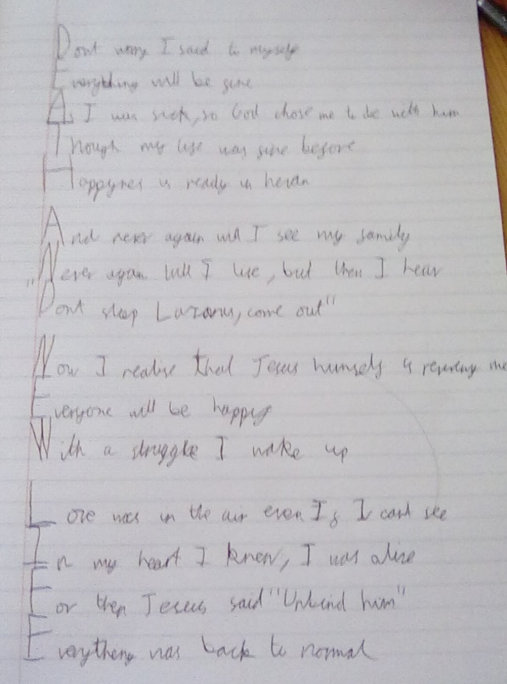
Olly

Slide 6
Karol
The death of Lazarus
Interviewer: Hello Jesus, how did you feel when everyone was upset?
Jesus: I felt exactly like them, I was devastated that Lazarus died.
Interviewer: How did you feel when they started asking you why you didn’t save him?
Jesus: I felt a punch of guilt to my heart.
Interviewer: What were your emotions when you saw Lazarus dead?
Jesus: I felt a pain in my heart, it was a disturbing sight.
Interviewer: How did you feel when Lazarus rose from the dead?
Jesus: It was a relief, I was joyous that he was alive. I felt the glory of my father in his heart.
Interviewer: How do you feel now it is over.
Jesus: It feels like being let free after 10 years in prison. I feel like a dove that was stuck in a trap, and finally being able to spread out my glorious wings and fly away and be free!
Interviewer: This is the end of your interview, you are the chosen one O’ Lord.

Slide 7
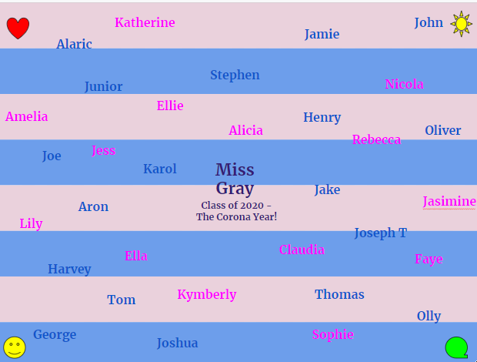
Nicola

Slide 8
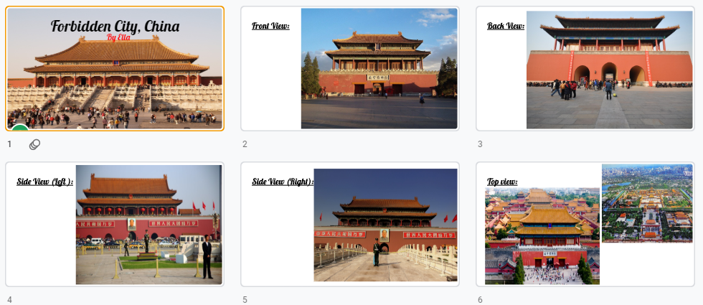
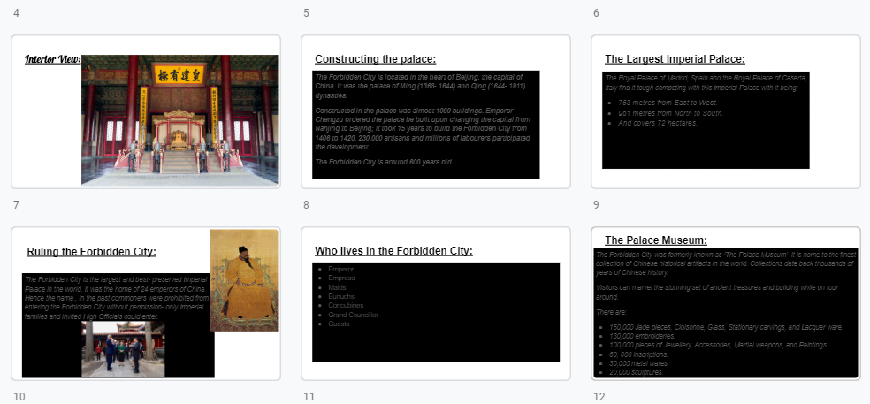
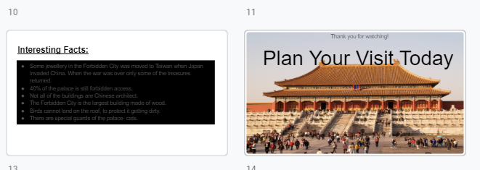
Ella

