Slide 1


Year 6 – Autumn Block 5 – Perimeter, Area and Volume – Area and Perimeter
About This Resource:
This PowerPoint has been designed to support your teaching of this small step. It includes a starter activity and an example of each question from the Varied Fluency and Reasoning and Problem Solving resources also provided in this pack. You can choose to work through all examples provided or a selection of them depending on the needs of your class.
National Curriculum Objectives:
Mathematics Year 6: (6M7a) Recognise that shapes with the same areas can have different perimeters and vice versa
Mathematics Year 6: (6M7c) Recognise when it is possible to use formulae for the area of shapes
More Year 6 Perimeter, Area and Volume resources.
Did you like this resource? Don’t forget to review it on our website.
© Classroom Secrets Limited 2019

Slide 2
Year 6 – Autumn Block 5 – Perimeter, Area and Volume
Step 2: Area and Perimeter
© Classroom Secrets Limited 2019

Slide 3
Introduction
Match the rectangle to the correct area and perimeter.
11cm
5cm
55cm² |  | 22cm
81cm² |  | 36cm
18cm² |  | 32cm
2cm
9cm
9cm
© Classroom Secrets Limited 2019

Slide 4
Introduction
Match the rectangle to the correct area and perimeter.
11cm
5cm
55cm² |  | 22cm
81cm² |  | 36cm
18cm² |  | 32cm
2cm
9cm
9cm
© Classroom Secrets Limited 2019

Slide 5
Varied Fluency 1
True or false? The area of this shape is 44cm².
 |  | 7cm
 | 130mm
 |  |  |  |  | 70mm
 |  |  |  |  |  |  |  |  | 3cm
 |  |  | 14cm
© Classroom Secrets Limited 2019

Slide 6
Varied Fluency 1
True or false? The area of this shape is 44cm².
False. The correct answer is 112cm².
13cm x 7cm = 91cm² + 7cm x 3cm = 21cm²;
91cm² + 21cm² = 112cm².
 |  | 7cm
 | 130mm
 |  |  |  |  | 70mm
 |  |  |  |  |  |  |  |  | 3cm
 |  |  | 14cm
© Classroom Secrets Limited 2019

Slide 7
Varied Fluency 2
Solve the word problem.
A room measures 16ft by 6ft. What is the area and perimeter of the room?
© Classroom Secrets Limited 2019

Slide 8
Varied Fluency 2
Solve the word problem.
Area = 16ft x 6ft = 96ft².
Perimeter = 16ft + 16ft + 6ft + 6ft = 44ft.
A room measures 16ft by 6ft. What is the area and perimeter of the room?
© Classroom Secrets Limited 2019

Slide 9
Varied Fluency 3
Calculate the area and the perimeter.
80mm
9m
A
500cm
B
14cm
© Classroom Secrets Limited 2019

Slide 10
Varied Fluency 3
Calculate the area and the perimeter.
A. Area = 9m x 5m = 45m²
A. Perimeter = 9m + 9m + 5m + 5m = 28m.
B. Area = 14cm x 8cm = 112cm²
B. Perimeter = 14cm + 14cm + 8cm + 8cm = 44cm.
80mm
9m
A
500cm
B
14cm
© Classroom Secrets Limited 2019

Slide 11
Varied Fluency 4
Which shape has an area and a perimeter that equal the same number?
4cm
B
5cm
4cm
7cm
6cm
5cm
2cm
A
20mm
9cm
2cm
© Classroom Secrets Limited 2019

Slide 12
Varied Fluency 4
Which shape has an area and a perimeter that equal the same number?
B
Area = 20cm²
Perimeter = 20cm
4cm
B
5cm
4cm
7cm
6cm
5cm
2cm
A
20mm
9cm
2cm
© Classroom Secrets Limited 2019

Slide 13
Problem Solving 1
Drew draws two equal rectangles.
He puts them together to make a new shape.
What is the area and perimeter of the new shape?
3cm
3cm
11cm
11cm
© Classroom Secrets Limited 2019

Slide 14
Problem Solving 1
Drew draws two equal rectangles.
He puts them together to make a new shape.
What is the area and perimeter of the new shape?
Area = 57cm²
Perimeter = 44cm
3cm
3cm
11cm
11cm
© Classroom Secrets Limited 2019

Slide 15
Problem Solving 2
A shape has a perimeter of 54cm. What is the largest area the shape could have?
What is the smallest area the shape could have?
Perimeter = 54cm
© Classroom Secrets Limited 2019

Slide 16
Problem Solving 2
A shape has a perimeter of 54cm. What is the largest area the shape could have?
What is the smallest area the shape could have?
Largest area = 13cm x 14cm = 182cm²
Smallest area = 26cm x 1cm = 26cm²
Perimeter = 54cm
© Classroom Secrets Limited 2019

Slide 17
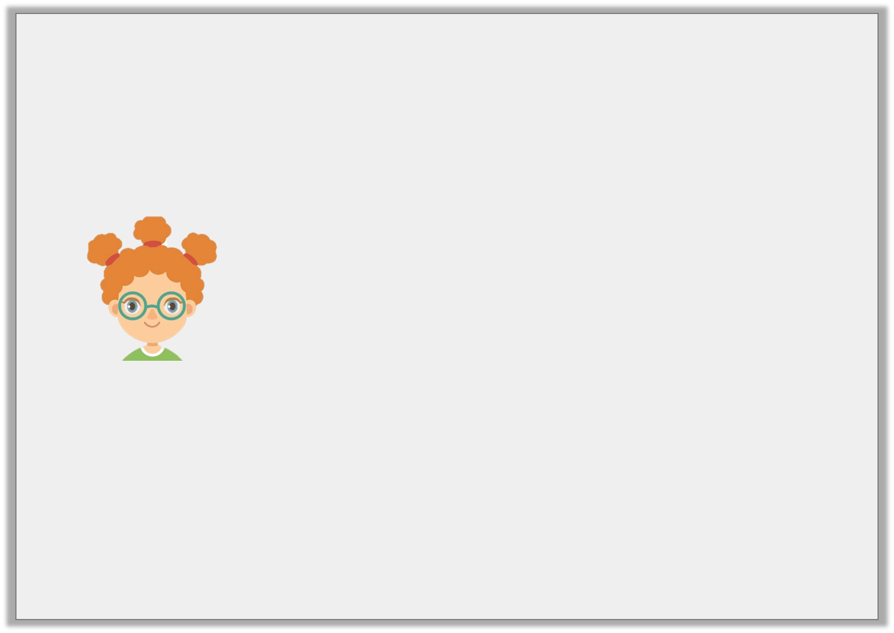
Reasoning 1
Milly says,
Do you agree? Prove it.
Area and perimeter are the same.
© Classroom Secrets Limited 2019

Slide 18
Reasoning 1
Milly says,
Do you agree? Prove it.
Milly is incorrect because…
Area and perimeter are the same.
© Classroom Secrets Limited 2019

Slide 19
Reasoning 1
Milly says,
Do you agree? Prove it.
Milly is incorrect because area is the space inside the shape and is found by multiplying the length by width. Perimeter is found by adding together the length of all the sides.
Area and perimeter are the same.
© Classroom Secrets Limited 2019

