Slide 1


Year 6 – Spring Block 5 – Perimeter, Area and Volume – Area of a Triangle 1
About This Resource:
This PowerPoint has been designed to support your teaching of this small step. It includes a starter activity and an example of each question from the Varied Fluency and Reasoning and Problem Solving resources also provided in this pack. You can choose to work through all examples provided or a selection of them depending on the needs of your class.
National Curriculum Objectives:
Mathematics Year 6: (6M7b) Calculate the area of parallelograms and triangles
More Year 6 Perimeter, Area and Volume resources.
Did you like this resource? Don’t forget to review it on our website.
© Classroom Secrets Limited 2019

Slide 2
Year 6 – Spring Block 5 – Perimeter, Area and Volume
Step 3: Area of a Triangle 1
© Classroom Secrets Limited 2019

Slide 3
Introduction
Work out the area of these compound shapes and order them from smallest to largest.
not to scale
 |  | 10m
5m |  |  | A
 |  |  |  |  | 11m
 | 900cm
 | 4m
8m |  |  | 400cm
 | B |  |  |  | 4m
 |  | 8m
 |  |  |  |  | 600cm
10m |  | C
 |  |  | 4m
© Classroom Secrets Limited 2019

Slide 4
Introduction
Work out the area of these compound shapes and order them from smallest to largest.
B = 48m², A = 56m², C = 64m²
not to scale
 | 4m
8m |  |  | 400cm
 | B |  |  |  | 4m
 |  | 10m
5m |  |  | A
 |  |  |  |  | 11m
 | 900cm
 |  | 8m
 |  |  |  |  | 600cm
10m |  | C
 |  |  | 4m
© Classroom Secrets Limited 2019

Slide 5
Varied Fluency 1
Find the area of each triangle by counting the squares, then order them from smallest to biggest.
A. |  |  |  |  |  | B.
 |  | C.
1 square = 1cm²
© Classroom Secrets Limited 2019

Slide 6
Varied Fluency 1
Find the area of each triangle by counting the squares, then order them from smallest to biggest. C, A, B
A. |  |  |  |  |  | B.
 |  | C.
1 square = 1cm²
© Classroom Secrets Limited 2019

Slide 7
Varied Fluency 2
If each square equals 1cm², find the area of these triangles.
 |  |  |  |  |  | B.
A.
© Classroom Secrets Limited 2019

Slide 8
Varied Fluency 2
If each square equals 1cm², find the area of these triangles.
A = 12cm² B = 7.5cm²
 |  |  |  |  |  | B.
A.
© Classroom Secrets Limited 2019

Slide 9
Varied Fluency 3
Each square equals 1cm². Match each triangle to its area.
 |  |  |  |  |  | B.
 | A.
 |  |  |  | C.
4cm²
6cm²
8cm²
© Classroom Secrets Limited 2019

Slide 10
Varied Fluency 3
Each square equals 1cm². Match each triangle to its area.
 |  |  |  |  |  | B.
 | A.
 |  |  |  | C.
4cm²
6cm²
8cm²
© Classroom Secrets Limited 2019

Slide 11
Problem Solving 1
Here are three triangles. Each square equals 1cm².
Create three questions about the area of the triangles. Remember to include answers.
 | A. |  |  | B.
 |  |  |  |  |  |  |  | C.
© Classroom Secrets Limited 2019

Slide 12
Problem Solving 1
Here are three triangles. Each square equals 1cm².
Create three questions about the area of the triangles. Remember to include answers.
Various answers, for example:
Which triangles have the same area? (B and C)
Which triangle has the largest area? (A)
Which triangles have a combined area of 10.5cm²? (A and B or A and C)
 | A. |  |  | B.
 |  |  |  |  |  |  |  | C.
© Classroom Secrets Limited 2019

Slide 13
Reasoning 1
Seth has worked out the area of these triangles, however he’s got them all wrong!
Each square = 1cm².
Correct and explain his mistakes.
Seth has calculated the area of the rectangles but has not halved it to get the area of the triangles.
 |  |  | A. |  | B. |  |  | C.
Area = 12cm² |  |  |  |  | Area = 15cm² |  |  |  | Area = 8cm²
© Classroom Secrets Limited 2019

Slide 14
Reasoning 1
Seth has worked out the area of these triangles, however he’s got them all wrong!
Each square = 1cm².
Correct and explain his mistakes.
Seth has calculated the area of the rectangles but has not halved it to get the area of the triangles.
 |  |  | A. |  | B. |  |  | C.
Area = 12cm² |  |  |  |  | Area = 15cm² |  |  |  | Area = 8cm²
Area = 6cm² |  |  |  |  | Area = 7.5cm² |  |  |  | Area = 4cm²
© Classroom Secrets Limited 2019

Slide 15
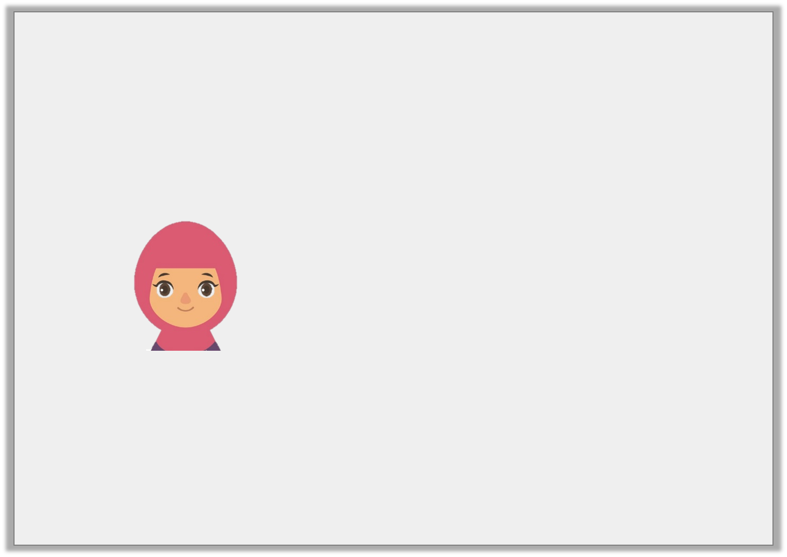
Problem Solving 2
Kiran is drawing a triangle.
She says,
Use squared paper to draw triangles with the same area as Kiran’s.
My triangle has an
area of 14cm².
© Classroom Secrets Limited 2019

Slide 16
Problem Solving 2
Kiran is drawing a triangle.
She says,
Use squared paper to draw triangles with the same area as Kiran’s.
Various answers. Accept any triangle or triangles drawn with an accurate area of 14cm².
My triangle has an
area of 14cm².
© Classroom Secrets Limited 2019

